Slide 1
Building Support for Global Development in the UK

Slide 2















The Narrative Partners
Notes:
Throughout 2013 and 2014 this group of NGOs have been working together to figure out how we can together change the conversation and build support for global development.
Can the public conversation about global development be changed to foster a more positive understanding of the issues?

Slide 3
Our Ambition
Reverse the decline of public support for our work
Find new ways for the sector talk to talk about our work and our selves
Create a climate that helps us all be more effective
Bring further coordination and consistency to our approach.

Slide 4
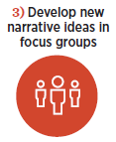
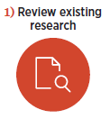
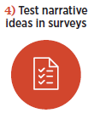
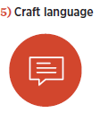
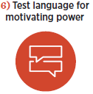
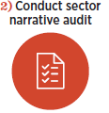
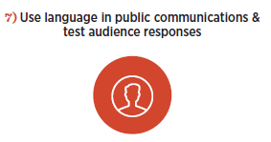
Methodology
Notes:
February to August 2014:
Review of existing research on public attitudes, in order to build upon prior knowledge and the work of others within the sector.
Audit of the frames development organisations use in their communications. Along with leaders in the development field, a team of social scientists, linguists, political advisors and public-opinion researchers contributed expertise and ideas.
Focus groups - develop and test ideas for a new narrative with people in the United Kingdom (also United States, France and Germany)
Online surveys with 1,200 members of the public
persuasive power of themes
ability to change attitudes
motivate people to take action
Powerful themes - crafted with a structure and language

Slide 5




A Comprehensive Approach
The primary objective was to learn something new about how to
change public attitudes – rather than greater understanding of existing attitudes.
Pre-research
Audit existing research
Create arguments
to test
Qualitative
Focus groups with stimulus
Quantitative
1200
person online interviews
per country
Engaged Public sample
Analysis
Perception shifts
Advocacy actions
Propensity to donate
Post-research
Create the narrative
Market Test
Sector Adoption
Notes:
Emphasis on the fact that we did this before, and this work is an ADDITION

Slide 6
Audience Overview

Slide 7
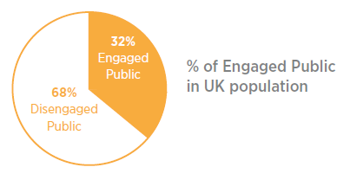
The Challenge
The Engaged Public in the UK represents less than a third of the population
Notes:
Only 32% of the adult population in the UK are engaged in the issues – and were therefore involved in the research
‘Engaged’ means: people who follow global issues, talk about them with others, and overall feel it’s important to improve health, education and economic opportunity for the world’s poorest people

Slide 8



Our Audiences For This Research
MUST be engaged with these issues to qualify for the research.
Supporters (41%)
Swings (47%)
Sceptics (12%)
Positive about development
Have taken action
Liberal and well-educated
Consume a lot of news media
Care about other social causes
High perceived social capital
Undecided about development
Would consider taking action
Generally younger than the Pros
Similar politically to the Pros
Care about other social causes, but a little less than Pros
Medium perceived social capital
Skeptical about development
At least willing to consider actions
Older
More Conservative
Care considerably less about other social causes
Medium perceived social capital
Notes:
Pros – 13% adult population of UK
Swings – 15% adult population of UK
Sceptics – 4% adult population of UK
Strategy:
Embolden the base; Swing the Swings; Appease the Sceptics
Supporters
positive attitude towards development and form a powerful base of support.
They volunteer, donate, raise their voices, and take action
They’re already on our side.
Swings
neutral to positive attitude towards development.
Feel a strong obligation to help people in the world’s poorest places
also believe that development programmes are wasteful.
Swings represent our biggest opportunity and could potentially double our base of support. If we can convince them that they can make a difference.
Sceptics
drive the negative narrative about development.
development is not effective and their attitudes are unlikely to change
can pull Swings away from positive perceptions of development

Slide 9
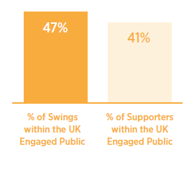
The Opportunity
Within the Engaged Public we can potentially double the support for development
Notes:
We can potentially double the number of people who support development if we can persuade Swings to think and feel more positively about development.

Slide 10
The narrative Approach

Slide 11
The Final Four Frames
Autonomy
Self-sufficiency, enduring change, and pride
Partnership
Joint-effort, mutual self-interest and equality
Progress
Improvement in circumstances, success stories and persistence
Morality
Urgency of the need, ethical and injustice
Notes:
The Narrative Project tested a variety of frames and the research showed that these four stood out as the most impactful with the Engaged UK audience:
Autonomy – best expressed as Independence
Morality – best expressed as Shared Values
Partnership
Progress

Slide 12
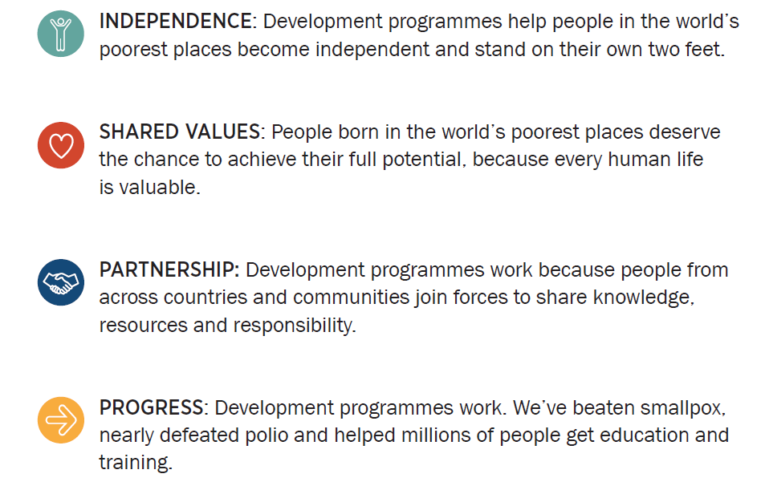
Narrative Messages
Notes:
Language testing with members of the Engaged Public showed that these were effective words and phrases to express the four narrative frames to our target audience.

Slide 13
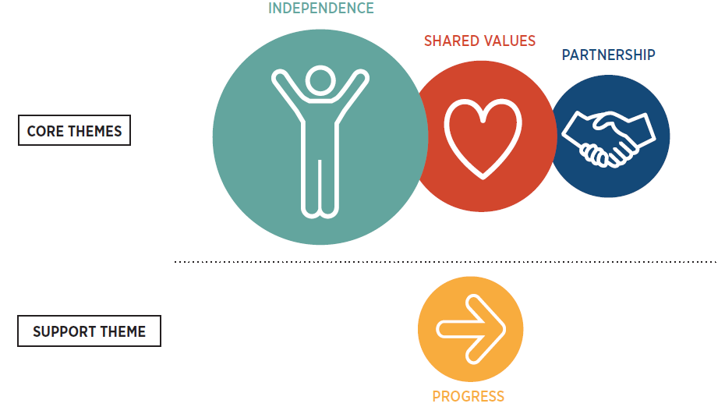
The Narrative Approach
Notes:
This is the formula for how these frames work together.
This approach persuades Swings, emboldens Supporters, and appeases Sceptics.
Independence – Emphasising independence as the end goal of development is the most compelling theme across all audiences—and helps convert the most Swings to Supporters
Shared Values - This theme reminds most people of a belief they already hold: every human life has value. That people living in the world’s poorest places have the same hopes and dreams as the rest of us and that we have a moral obligation to help them reach their potential
Partnership – Explaining that people in developing countries actively participate in making development programmes work is a critical theme for Swings
Progress – This is not persuasive on its own, but is a supporting theme. The theme that development programmes are effective supports the other ideas in the narrative by educating the public about what has been achieved.

Slide 14
The Narrative Tagline
“Offering a hand up so everyone can stand on their own two feet”
Theme: development helps people achieve independence
Notes:
The most important lesson from The Narrative Project research: “independence” as the end goal of development
The key lesson is that the world’s poorest people have both the desire and the potential to stand on their own two feet and control their own destinies. This finding challenges the development sector’s current communications practices. It also has the power to transform our work and its impact.
In the language testing ‘independence’ was the most popular term for the theme of self-sufficiency/autonomy.

Slide 15
In practice

Slide 16
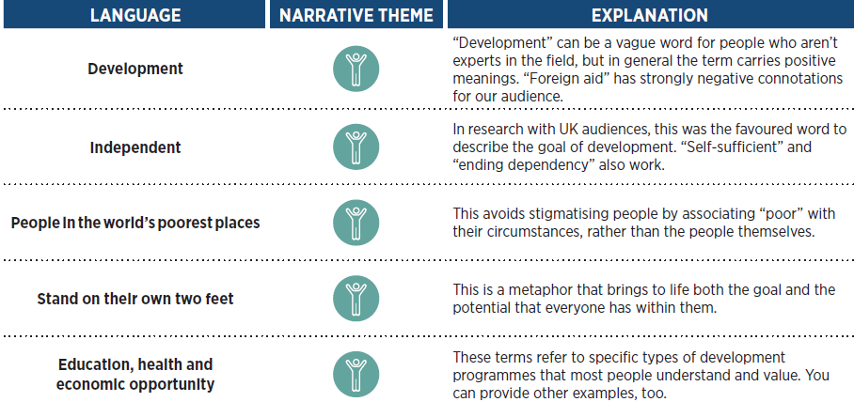
Language Tips: General
Notes:
This language tested well with all audience segments.
There is also specific information in the Narrative Project User Guide about which narrative themes to emphasise with each audience – Supporters; Swings; Sceptics

Slide 17
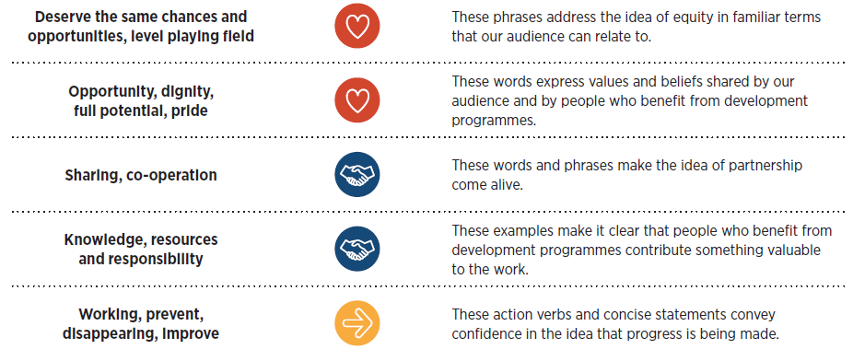

Slide 18
Research Insights: Dos
Do lead with the theme of “independence” as the purpose of development programmes.
Do talk about empowering women and girls in the developing world.
Do provide examples of progress in the context of other ideas in the narrative.
Do highlight partnership in all aspects of development programmes.
Do emphasise core human values and priorities that are relatable to both donor and developing country audiences.

Slide 19
Research Insights: Don’ts
Don’t expect facts and figures about progress alone to convince people to support development.
Don’t invoke pity or characterise people in developing countries as helpless victims or assert that people have an obligation to support development.
Don’t lead with negative concepts or words.
Notes:
There is also more information in the User Guide on:
Campaign messaging
Messages for speaking
An example of a success story
Example Facebook posts, Tweets, and Blogs
Creative images to represent each narrative theme
A creative brief and a content creators checklist

Slide 20
Don’t use long-term timeframes to communicate a goal or vision.
Don’t use the term “foreign aid.”
Don’t describe the goal of development as furthering the economic or national security interests of donor countries.
Don’t try to downplay the problem of corruption or minimalise the scale of it.

Slide 21
Next steps?
Notes:
The next step is to try out the narrative approach in the real world. It can be used to create anything from speeches to video content to social media. To determine if The Narrative Project approach can truly help change the conversation, organisations need to test it for themselves, see what works, refine, and test again.

Slide 22
OVER TO YOU

Slide 23
Areas for discussion…
  3 areas of discussion
  Reactions to the research insights
  Thinking about the research – what are you excited about? Confused about? What else should be considered?
  Thinking about applying the research and proposed tools – what are the barriers? What are the opportunities? What ideas do you have?

Slide 24
THANK YOU!
For more information:
Alice Delemare, Campaigns Adviser, Bond
adelemare@bond.org.uk

