Slide 1

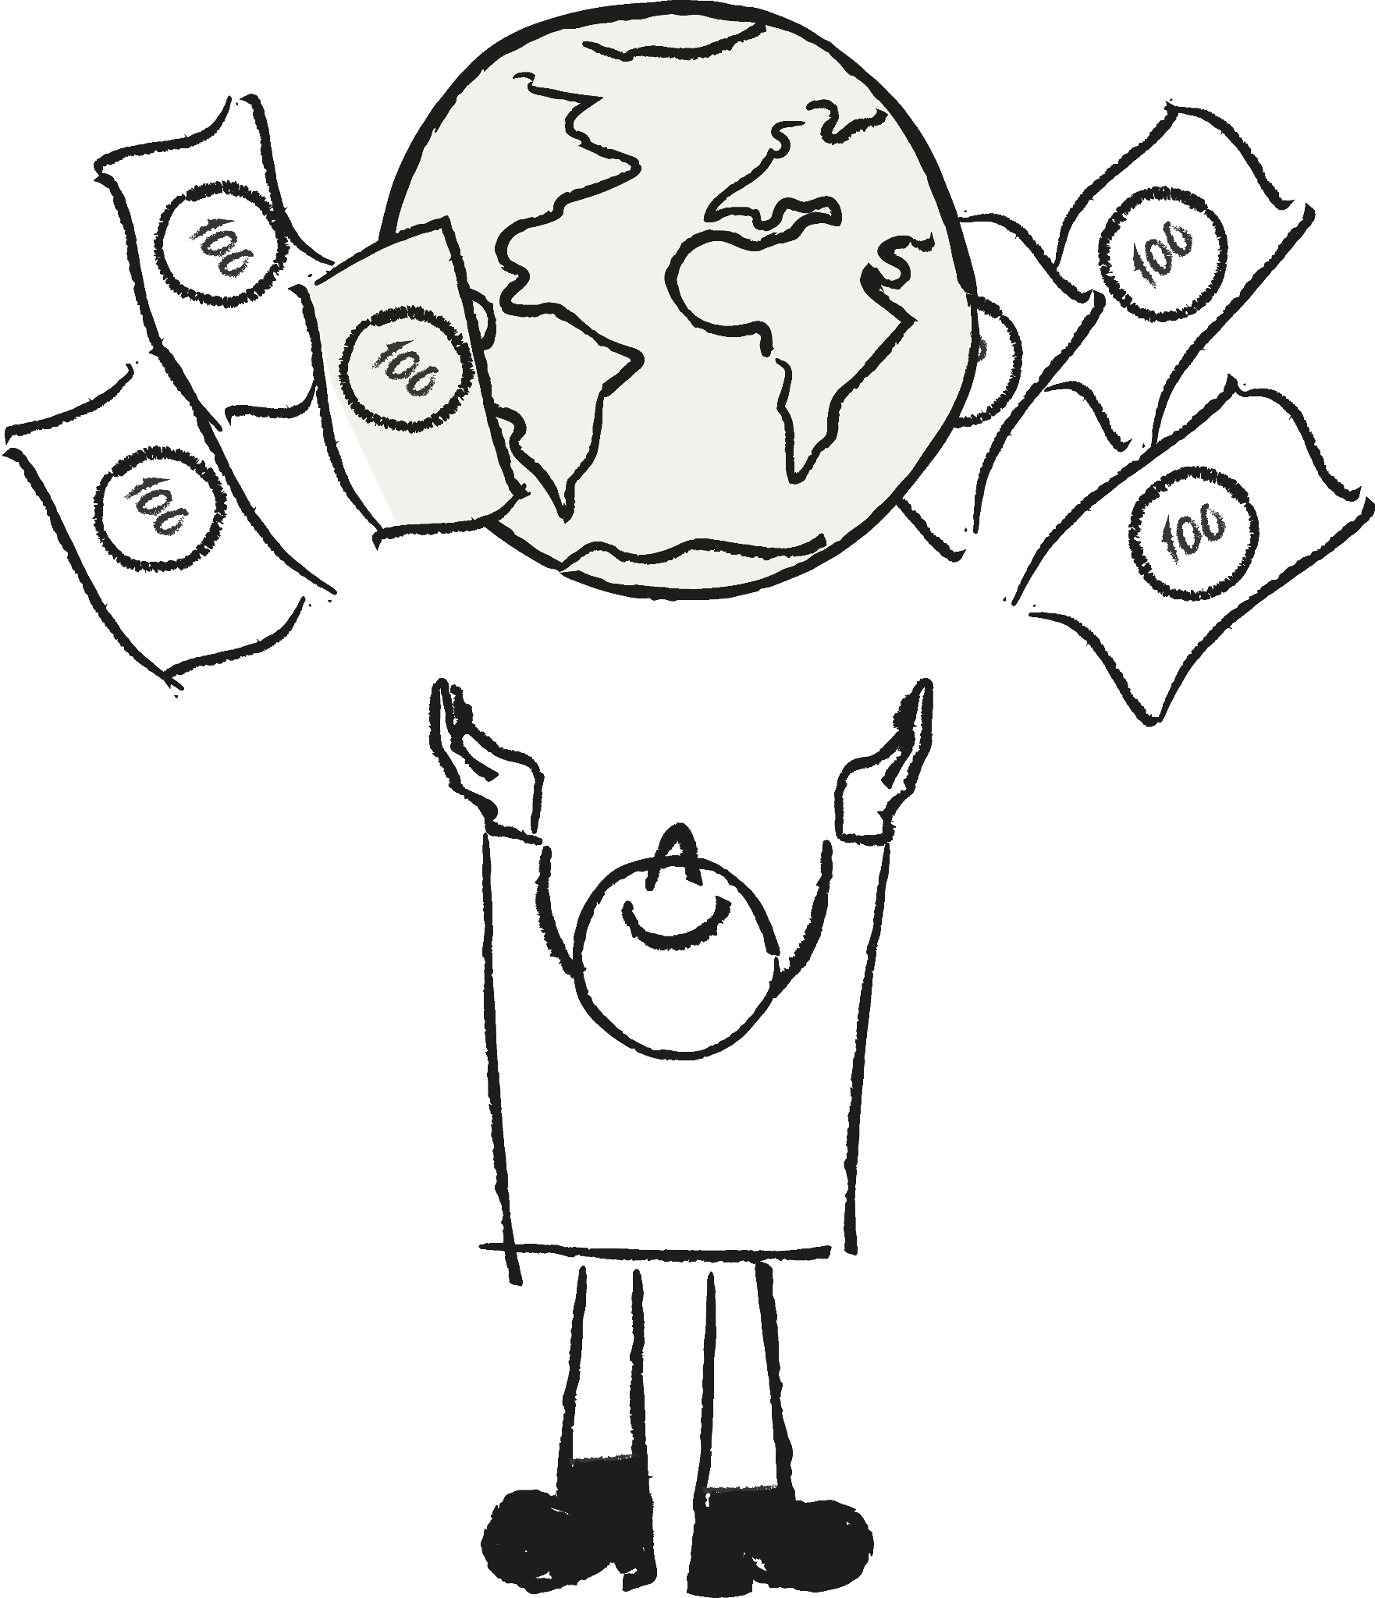
MONEY
TALKS
2023
How to win support for investment in action on climate and development
by changing the way we talk about it.

Slide 2



THE RESEARCH
In 2022 we embarked on a landmark research project, to understand how can we unlock mass support for international investment in climate and development. In 2023, we built on these findings and expanded the reach of the survey beyond the G7 ...
15 countries
G7+
Australia
Canada
France
Germany
Italy
Japan
UK
US
Emerging Economies
Argentina
Brazil
India
Indonesia
Kenya
Nigeria
South Africa
30,000 People
(2,000 in each country)
Fieldwork conducted August 2023

Slide 3

CONCERNS
In context
A look at public perceptions of climate action in a wider context.

Slide 4



What’s on people's minds?
We asked what issues will be on their minds when voting at the next national election.
Emerging
ECONOMIES
45%
Cost of living
G7+
35%
32%
30%
30%
Unemployment
27%
Corruption
State of the economy
Cost of living
25%
24%
Healthcare
Climate change
State of the economy

Slide 5



2. Climate is a consistent concern
While it isn’t a top voting concern, climate change is a significant concern across all markets.
38%
All 15
countries
Cost of living
Climate change appears to get drowned out by other more acute issues, especially during times of economic anxiety.
26%
State of
the economy
23%
21%
20%
Healthcare
Unemployment
Climate change

Slide 6
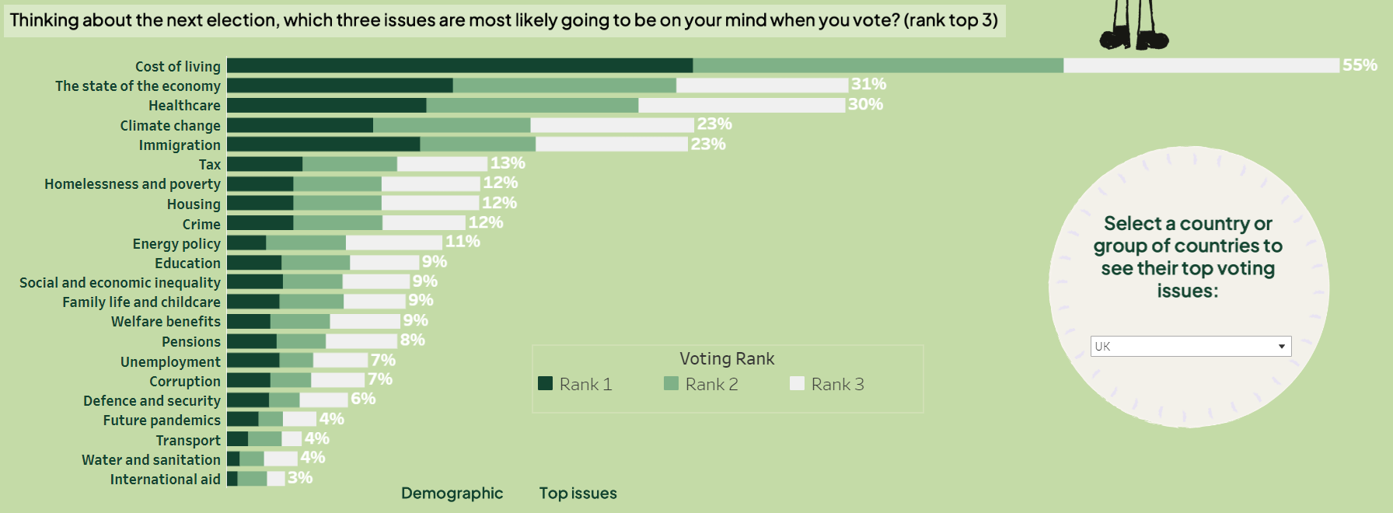

Slide 7

3. Climate concern is contextual
Concern for the negative impacts of climate change is high across all countries.
But concern is significantly higher in Emerging Economies (EE), where the impacts
of climate change are felt more directly.
42% of 2019 Conservative voters are very concerned about climate change (8+)
How concerned are you about the negative effects of climate change?
G7+
EE
6.8
7.9
Not concerned at all
Very concerned
0
5
6.6
10
UK

Slide 8
3. Climate concern is contextual
In G7 countries, we’ve observed a small but significant decline in concern for climate change. Concern has dropped most steeply in France, Germany and Italy. This is likely because of a worsening economic context.
How concerned are you about the negative effects of climate change?
G7
2023
2022
6.9
7.3
Not concerned at all
Very concerned
0
5
10

Slide 9
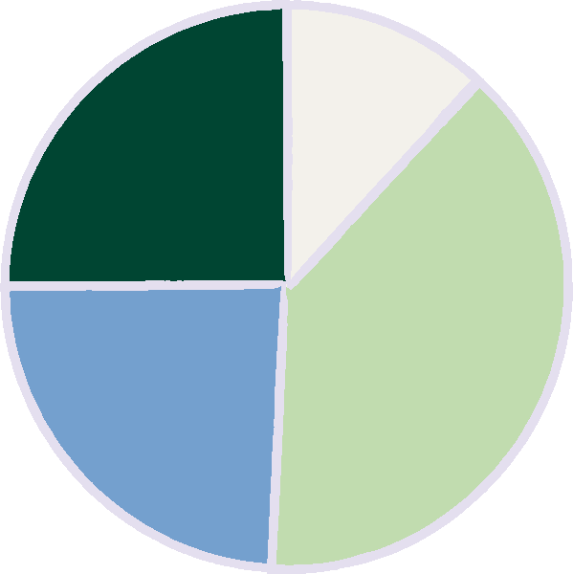
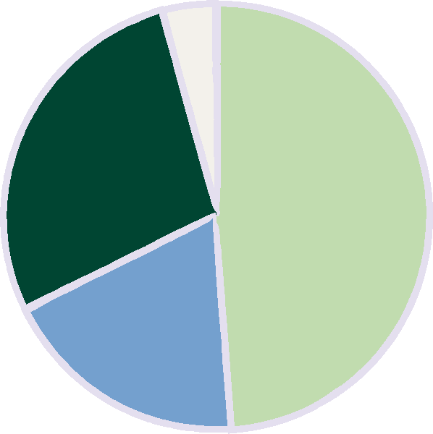
4. investment in climate action has broad support
“Money used to fund initiatives to tackle climate change is another cost we can’t afford at the moment. There are more pressing global issues.
Respondents in the majority of countries believe funding climate action is either a requirement or a good investment in our future.
“Climate change funding is an opportunity and a good investment in our future”
4%
12%
25%
28%
“Climate change funding is important. It may be difficult in the short term, but it is a requirement and we definitely need to do it in the long term.”
49%
39%
24%
19%
G7+
EE
“Don’t know”

Slide 10
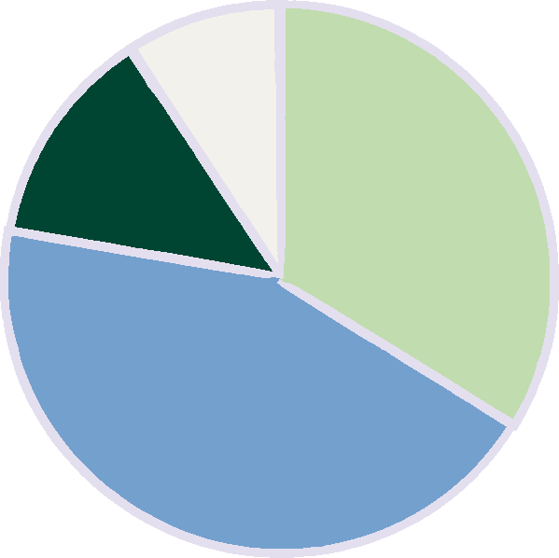
4. investment in climate action has broad support
However, a significant amount of citizens prefer the idea of investing in climate action at home, instead of abroad. In the G7 this tendency has increased since 2022.
9%
13%
34%
“By investing in other countries, we can help them do their part in tackling global problems like climate change”
“We should not be spending money on tackling climate change at all”
44%
“Don’t know”
“To tackle climate change we should be spending money at home, not abroad”

Slide 11
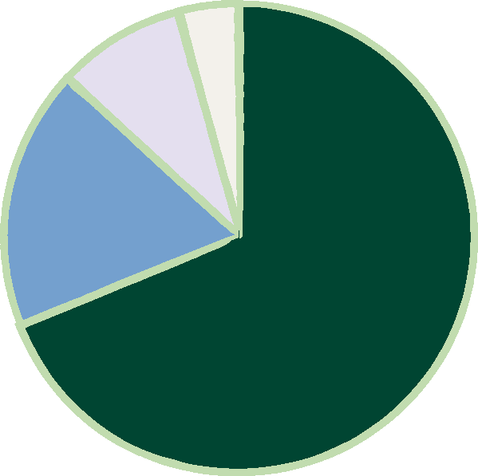
5. All nations agree rich countries should pay more
Although emerging economies agree more strongly.
4%
“High income countries should bear a larger part of the costs of climate action than lower income countries because they are historically responsible for more damage to the climate”
9%
Disagree
18%
Neutral
69%
Agree
69% agree
18% neutral
9% disagree
4% don’t know
UK = 62% agree; 11% DISAGREE

Slide 12
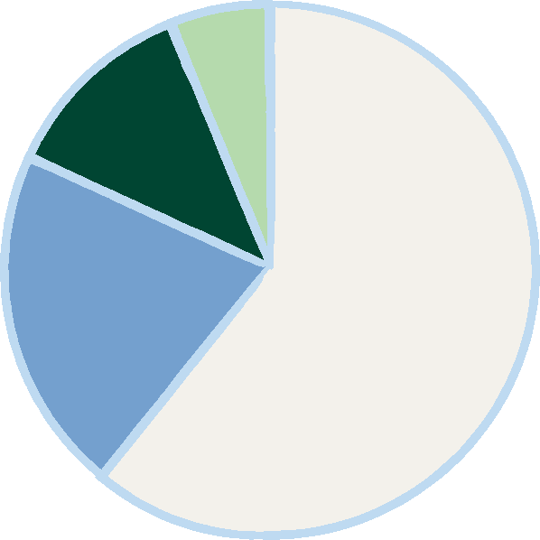
6. Affordable finance for emerging markets has high support
There is a high level support for making loans more affordable for emerging economies, to enable them to fight climate change and improve health, education and livelihoods. Japan was a notable exception.
6%
12%
Disagree
Support is highest amongst emerging economies.
21%
61%
61% agree
Neutral
Agree
21% neutral
12% disagree
6% don’t know
UK = 56% agree; 11% DISAGREE

Slide 13



7. Trust is a matter of perspective
If the following countries were to invest in lower-income countries, which would you trust to have the best interests of that other country at heart?
36%
USA
29%
28%
UK
Canada
18%
18%
16%
UAE
China
Italy
…
Top Three
Bottom Three

Slide 14
If the following countries were to invest in lower-income countries, which would you trust to have the best interests of that other country at heart? (select all that apply)
 | All Nations | G7 & Australia | Emerging Economies | African Nations
USA | 36% | 28% | 45% | 51%
UK | 29% | 25% | 33% | 40%
Canada | 28% | 28% | 27% | 31%
Germany | 27% | 25% | 29% | 33%
Japan | 26% | 20% | 32% | 27%
France | 22% | 21% | 22% | 23%
UAE | 18% | 9% | 29% | 28%
China | 18% | 7% | 30% | 39%
Italy | 16% | 16% | 15% | 14%

Slide 15


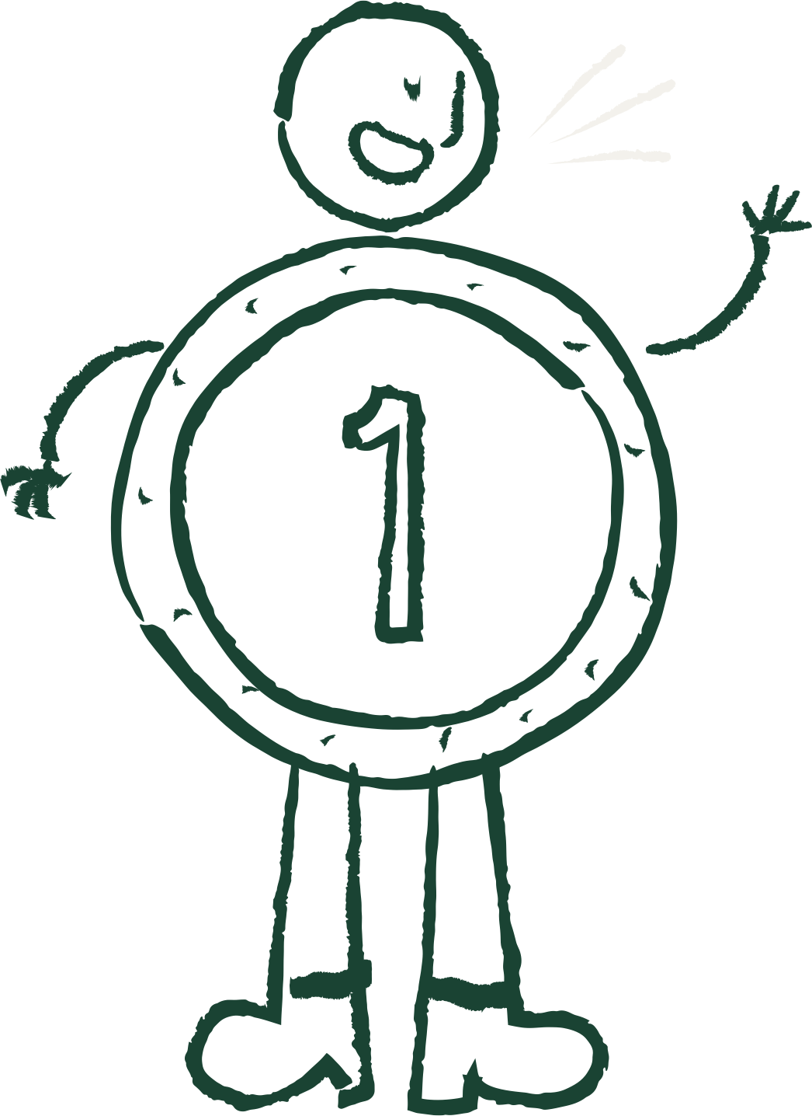
There isn’t a one-size-fits-all script.
But communicating in the right way can substantially increase support, by up to 20%!
How we talk
About investing
In action
Really matters.

Slide 16
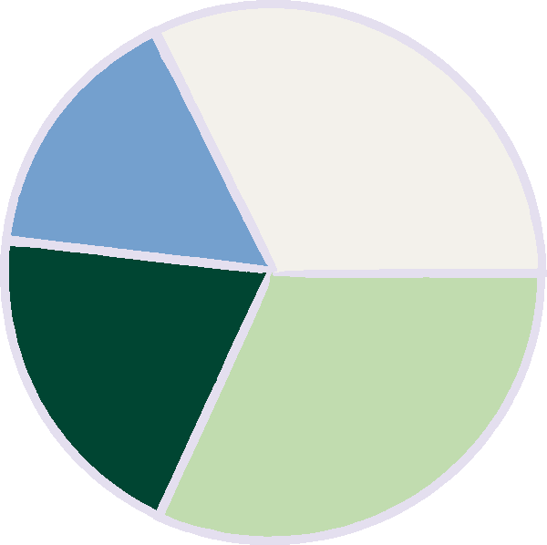
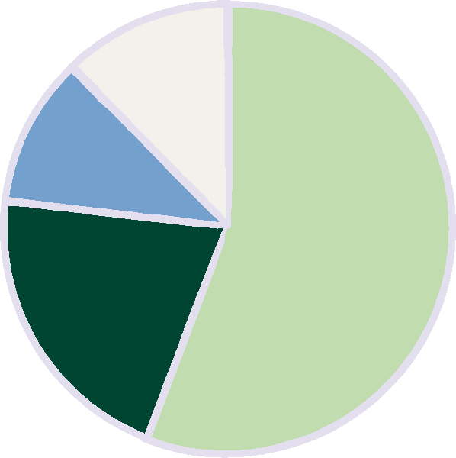
E.g. ‘Climate justice’
is polarising in G7+ but supported in Emerging Economies.
12%
“I understand what it means and think it is an important concept. We need climate justice.”
32%
16%
11%
56%
“I understand what it means but don’t have an opinion about it.”
20%
21%
32%
“I understand what it means and don’t like what it stands for.”
G7+
EE
“I don’t understand what it means”

Slide 17
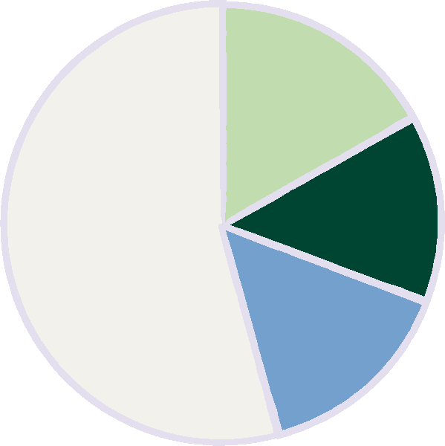
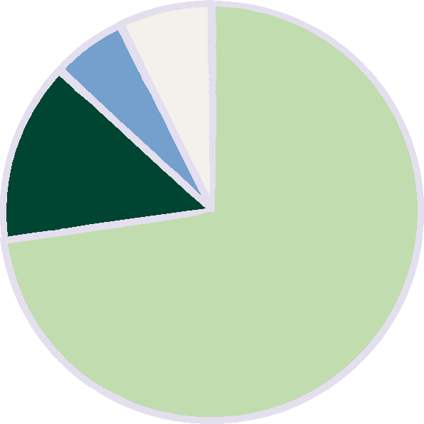
UK:
28% support
20% no opinion
15% don’t like
36% don’t understand
E.g. ‘Climate justice’
is polarising in G7+ but supported in Emerging Economies.
12%
“I understand what it means and think it is an important concept. We need climate justice.”
17%
11%
14%
14%
56%
“I understand what it means but don’t have an opinion about it.”
54%
73%
21%
6%
15%
“I understand what it means and don’t like what it stands for.”
7%
“I don’t understand what it means”
japan
Kenya

Slide 18
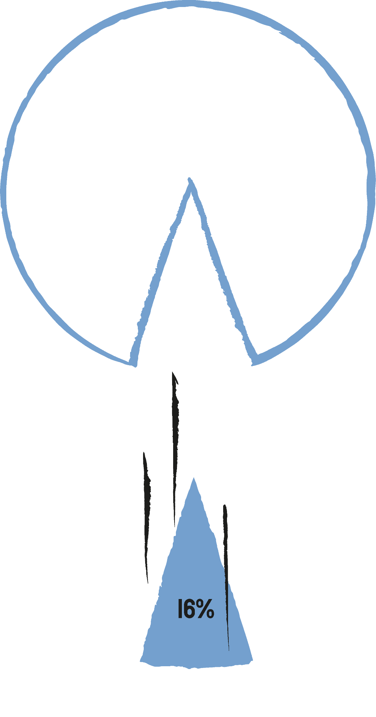

Our messages need to reach beyond the bubble!
The research identified a relatively small group of highly concerned, highly active people, ‘anxious globalists’ in the G7.
But is 16% of the population enough to create a movement?

Slide 19



We need to meet the masses in the middle
5%
16%
White Collar
Entrepreneurs
Anxious
Globalists
16%
Core Nationalists
17%
We’ve identified two influential and persuadable groups :‘Soft Right’ and ‘Middle Class Moderates’.
Their voices carry significant weight in domestic politics
Soft
Right
21%
Share of g7 population
Disengaged
5%
21%
Left Behind
Traditionalists
Middle Class
Moderates

Slide 20



Six effective
Comms tactics
To Win support beyond the bubble.

Slide 21

Tactic 1
Start with what they care about.
Cost of living
The economic case
Domestic focus
G7+
Most people are preoccupied with immediate concerns such as paying bills or finding a job. Messages need to be sensitive to their daily reality.
Jobs
State of the economy
Climate justice
EE
Given economic anxieties, messaging should connect climate and development finance initiatives with their positive impact on living costs, the future economy, and – especially in emerging economies – jobs.
recommendation

Slide 22
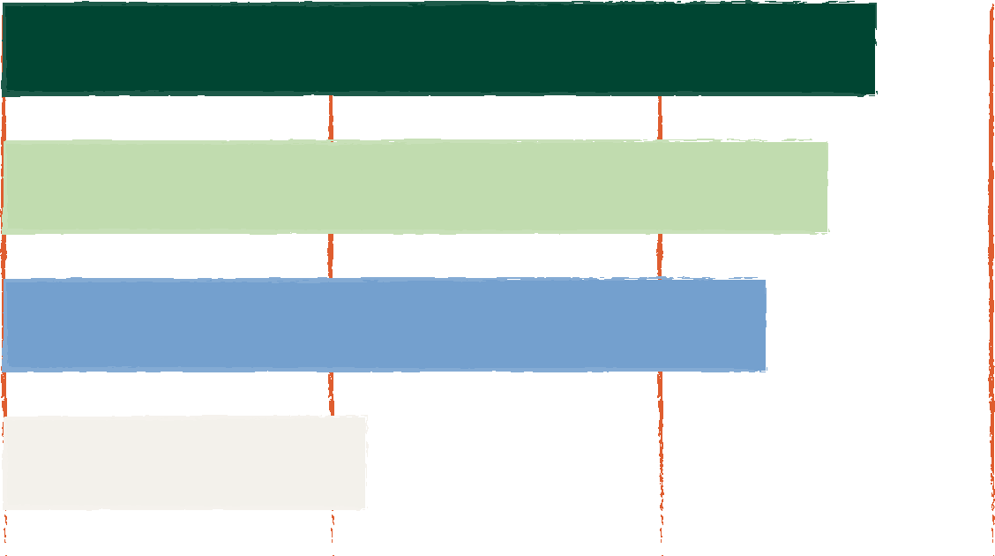
Tactic 2
nature and cost of living can Open the door
% think their government should spend more
Helping people deal with the cost of living
53%
Do you think that the national government is currently spending too much, not enough, or the right amount on the following issues?
Protecting and restoring nature
50%
Tackling climate change
46%
Aid to poorer countries
23%
0%
20%
40%
60%

Slide 23


Tactic 2
nature and cost of living can Open the door
UK support for climate change (46%), nature (47%), cost of living (57%)
Tackling climate change is supported by 50%+ of respondents in South Africa, Kenya, France, Italy, and Argentina.
In Argentina, Brazil, France, Germany and Italy “protecting and restoring nature” received the most support.
recommendation
Consider positioning government investment in terms of responding to the cost of living crisis or protecting and restoring nature.
This particularly increases support amongst the mainstream “middle” and those who see climate action or investment in other countries as less of a priority.

Slide 24
Question: “Imagine that a global fund was established with enough money and expertise to really make a difference in addressing problems relating to climate change, the environment, poverty, hunger, and inequality in the world’s lower income countries.
Which of the following areas would you be most and least excited to invest in?”
Tactic 3
For international investment, bring it back to basic needs.
1. Clean water
1. Green jobs
G7+
2. Hunger
2. Education
3. Fighting disease
3. Fighting disease
Emerging
economies
12. Tackle deforestation
12. Tackle deforestation
13. Build infrastructure
13. Build infrastructure
Most and least popular options from a list of 14 options
14. Sustainable transport
14. Sustainable transport

Slide 25


Tactic 3
For international investment, bring it back to basic needs.
Addressing immediate human needs is generally seen as a more exciting use of a ‘global fund’ than focusing on longer-term investments.
recommendation
When communicating the impacts of international investment in climate and development, highlight how it will address immediate human needs for G7+ audience, and emphasise the creation of jobs for Emerging Economies.

Slide 26

Tactic 4
Win-wins work
Control Proposal A:
This project would support sustainable farming and food production.
Question: Please imagine that [your government] has put forward a plan to invest $10 million in a lower income country…
Treatment Proposal:
This project would support sustainable farming and food production. This would allow them to export food to [your country] more reliably and at a lower cost.
Results

Slide 27
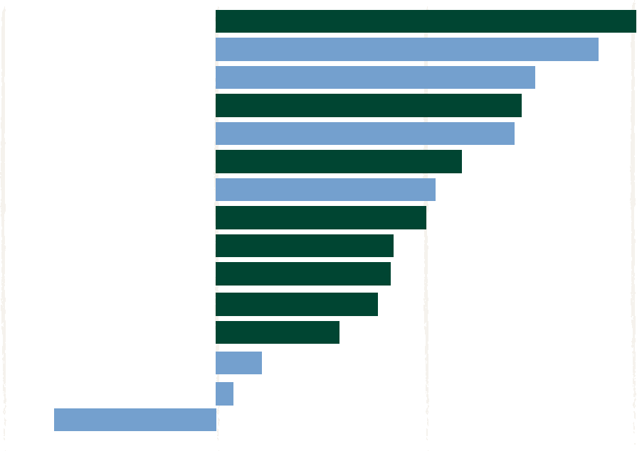
Greater support for Control Proposal
Greater support for Treatment Proposal
Canada
Argentina
South Africa
United Kingdom
Brazil
Japan
Indonesia
Australia
United States
France
Italy
Germany
Nigeria
India
Kenya
20%
18%
15%
15%
14%
12%
11%
10%
Kenya showed less support for the treatment proposal but there were high levels of support for both statements overall.
8%
8%
8%
6%
2%
1%
-8%
-10%
0%
10%
20%

Slide 28
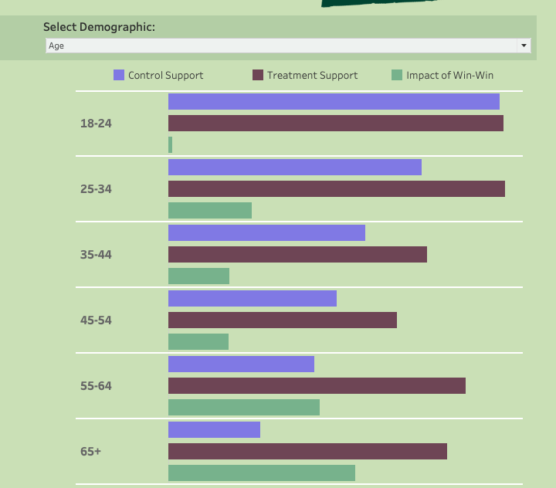
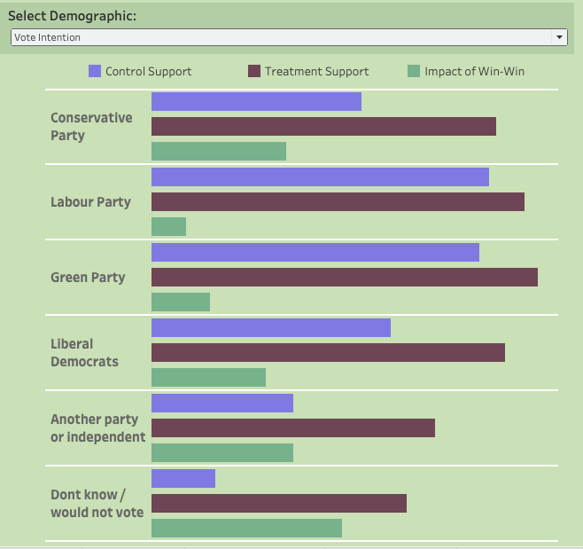

Slide 29

Tactic 4
recommendation
When persuading people about the need to invest in international action, highlight a tangible benefit that resonates with the home country of the audience you’re speaking to.
Win-wins work
By communicating the win-wins, it led to an average increase in support of 9%, and in some countries significantly more.
This is particularly effective in countries where the public are initially less open to investing in lower income countries
Highlighting win-wins that related to reducing forced migration* and improving food security**, were particularly effective.
* ”Can help prevent people from being forced to flee their homes and migrate to other countries, benefiting global stability.”
** ”Supports stable global food supplies and prices, benefiting all countries.”

Slide 30

Tactic 5
MAKE POLLUTERS PAY!
Globally, 73% of respondents support “polluter pays” policies - that would tax industries that profit from fossil fuels in order to fund poor countries to reduce their carbon emissions.
UK support = 66%
The more polluted the country, the more they agree.

Slide 31
Tactic 6
Trillions and billions don’t work
We asked…
To tackle the climate crisis and reduce global poverty, people have argued that we would need [XX] of additional funding and investment worldwide. Would you support or oppose a campaign that would advocate for this level of investment to be made available?
options
1. $2.4 Trillion
2. Funding equivalent to 2-3% of global GDP
3. Funding equivalent to 2-3% of global GDP.
This is the same as the world spends on
military and defence spending each year
4. Whatever it takes

Slide 32


Tactic 6
Trillions and billions don’t work
Germany, India, Indonesia, Italy, Japan, Kenya, Nigeria, South Africa, US
>
$
%
Communicating cost as a percentage of global GDP increased support by an average of 7%
In some countries, changing the framing increased support
by 10 - 20%;
UK support increases 4 - 8%
Argentina, Canada, Brazil, Germany, Australia, UK, France
+
>
$
%
recommendation
Don’t talk about billions and trillions! Instead create a meaningful comparison to give your audience context.

Slide 33
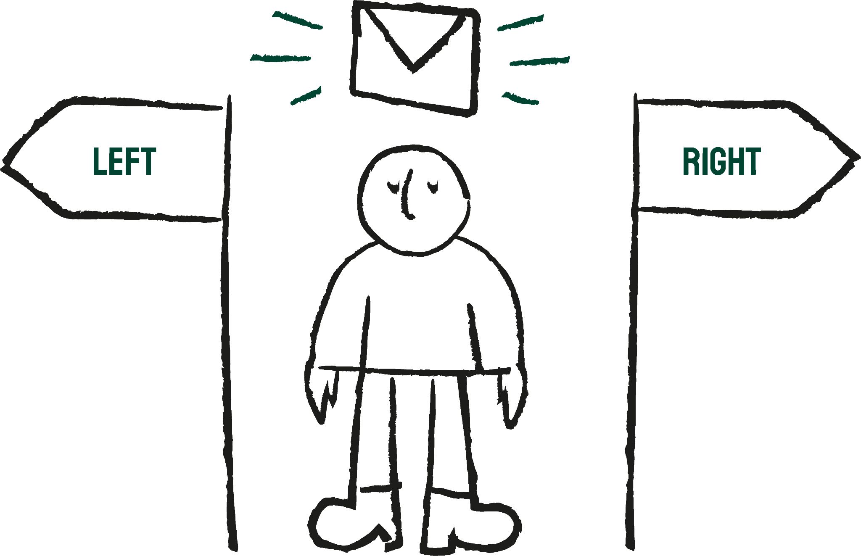
The messenger
matters.

Slide 34


The most trusted climate messengers
A significant number of people don’t know who to trust when it comes to climate change. Scientists were the most trusted from our list.
41%
Scientists
34%
Environmental
organisations
22%
20%
International
organisations
Victims of
climate disaster

Slide 35


The least trusted climate messengers
This reflects last year’s findings that ‘middle class moderates’ and ‘soft right’ audiences in the G7 don’t like partisan voices or activist language.
12%
Activists
9%
Local government
8%
Fossil fuel companies

Slide 36
In conclusion

Slide 37

DON’T
1
Let your message become too disconnected from people’s daily lives.
Assume that a message that works for one country or audience will work for another.
2
Talk about the cost of tackling climate change and global poverty in billions and trillions.
3
Use activists as messengers to reach mass audiences.
4

Slide 38

DO
1
Connect communications to what your audience really cares about e.g. cost of living, nature.
2
Highlight the win-wins! Connect investment in action with tangible benefits that resonate locally.
3
Talk about making polluters pay for climate action.
4
Talk about the cost of tackling climate change and global poverty as a % of GDP or another meaningful comparison.
5
Try to find “messengers in the middle” to reach mass audiences.

Slide 39

Let’s not forget…
The majority of people, across all countries, care about climate change and support investment in action on climate and development!

Slide 40
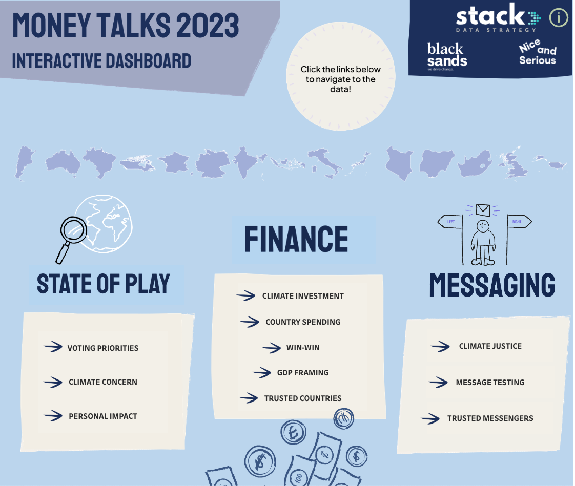

Dashboard
We have also created an interactive dashboard where you can toggle between country and demographic specific results

Slide 41
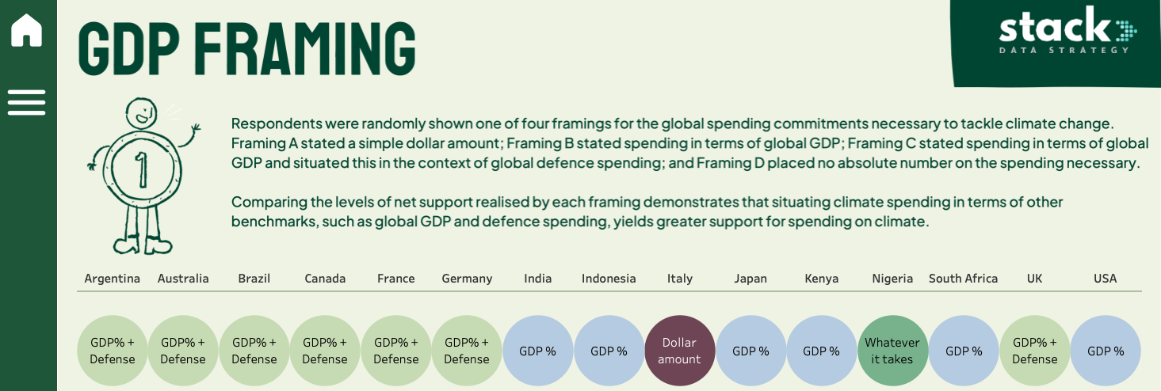

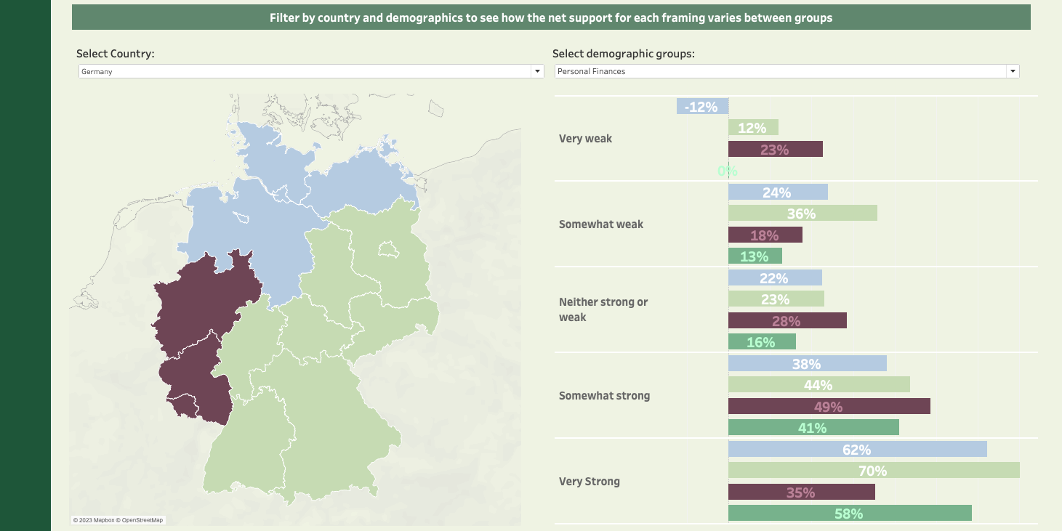
And in Germany personal finances as well as region influence which GDP framing is preferred

Slide 42
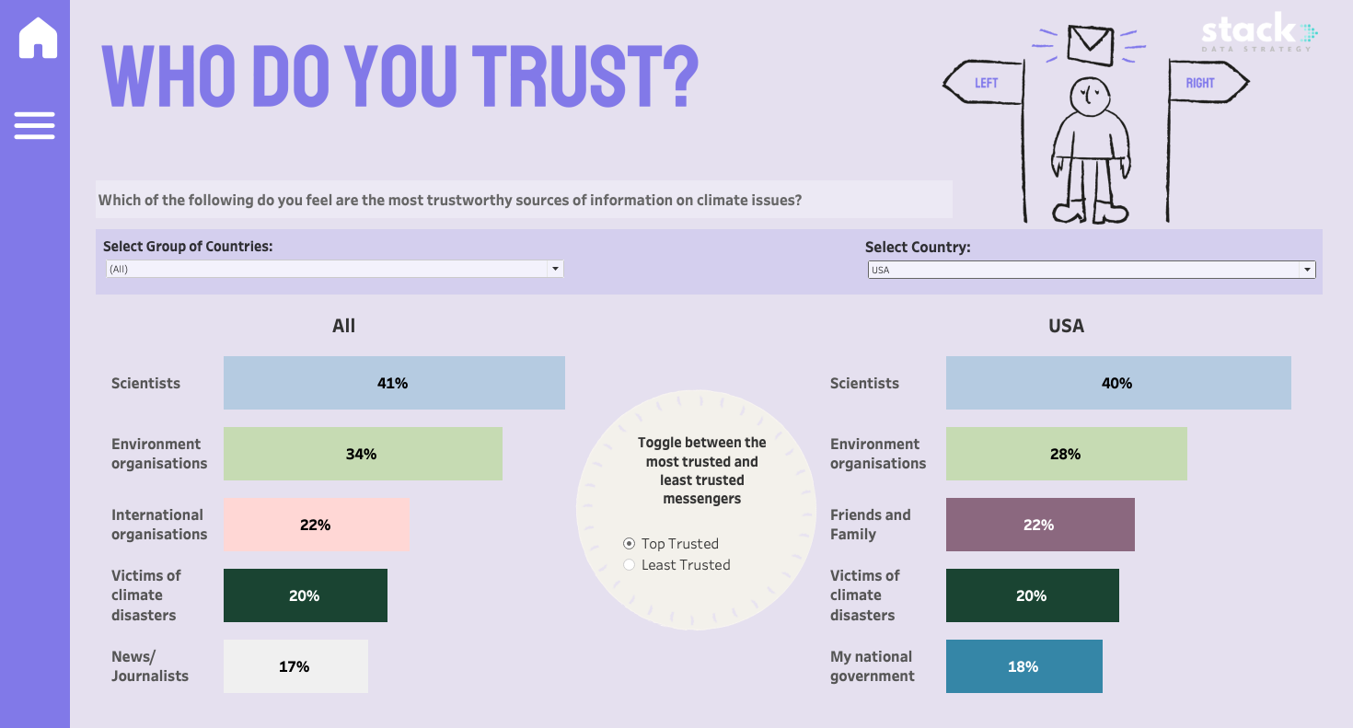
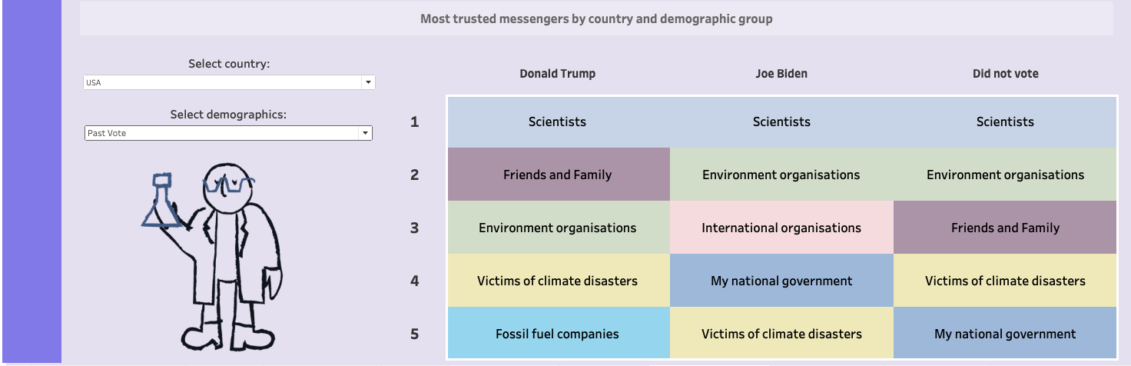
Political affiliation also plays a big role. For example, trusted messengers in the US vary significantly by past vote

Slide 43

Find out more
Resources
DASHBOARD
including full research report can be found on Trello
Find out more
Get in
touch
with Liz and Rachel:
hello@blanksands.co.uk
www.moneytalksresearch.org

Slide 44
Methodology
Research was undertaken by Stack Data Strategy
30,034 online interviews were across the G7, Australia, Argentina, Brazil, India, Indonesia, Kenya, Nigeria and South Africa (approximately 2,000 per country)
Fieldwork was conducted between 18 August
and 1 September 2023.
Survey responses in all countries except Nigeria and Kenya were weighted to be representative of respective national adult populations by age and gender (interlocked), educational attainment level, region of residency, and past political voting behaviour. In Nigeria and Kenya, responses were weighted to be representative of regular internet users by the same variables. Due to weighting and rounding, percentages may not always add up to 100%.

Slide 45




Research
PROJECT PARTNERS
Research was undertaken by Stack Data Strategy
Research consisted of a poll of 30,000 people across the G7, Australia, Argentina, Brazil, India, Indonesia, Kenya, Nigeria and South Africa (2000 per country)
Fieldwork was conducted between 18 August
and 1 September 2023.
Huge thanks to ONE, Earth4ALL, Global Citizen, E3G, Sharing Strategies, African Climate Foundation, GSCC, Project Everyone and others for their inputs and support.

